Slide 1

💄 BEAUTY PRODUCT SALES ANALYSIS
By Shrawani Gongshe

Slide 2
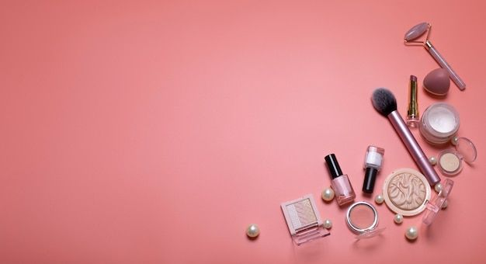
What is this project about?
Content:
Analysis of beauty product sales over the past year
Focused on top brands, discounts, product performance
Used: MySQL, Jupyter, Python, Seaborn/Matplotlib
Visual insights to guide business decisions

Slide 3

Dataset at a Glance
Content :
Time period : June 2024 – June 2025
Records : 1,000+ beauty product listings
Columns : Brand, Category, Product, Price, Discount, Rating, Units Sold, Stock Status
Source : Synthetic dataset created for analysis

Slide 4

Technologies Used
Content:
🐬 MySQL Workbench (data queries)
🐍 Python + Pandas (data processing)
📊 Seaborn/Matplotlib (visualization)
🧠 SQL concepts: aggregation, filtering, grouping, ordering

Slide 5

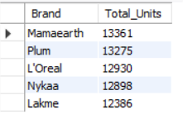
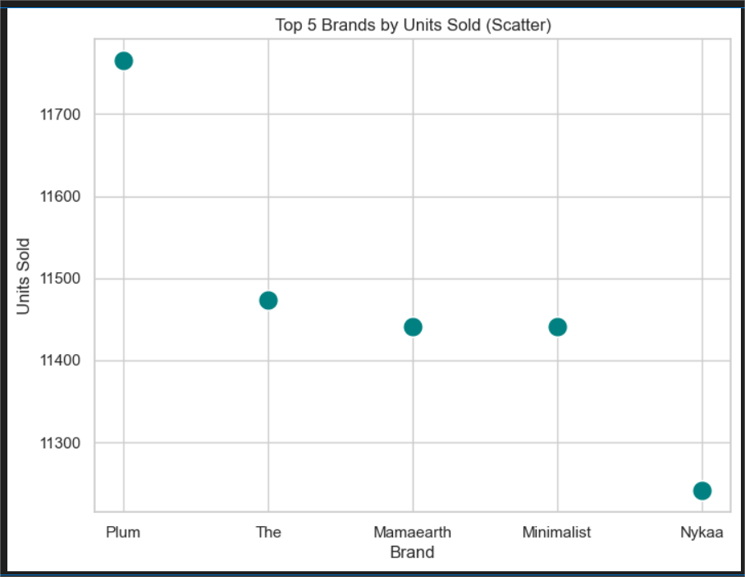
Top 5 Brands by Units Sold
Insights : Mamaearth leads with over 13,000 units sold, followed closely by Plum.
SELECT Brand, SUM(`Units Sold`) AS Total_Units
FROM beauty_sales
GROUP BY Brand
ORDER BY Total_Units DESC
LIMIT 5;

Slide 6
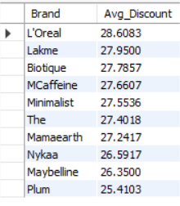
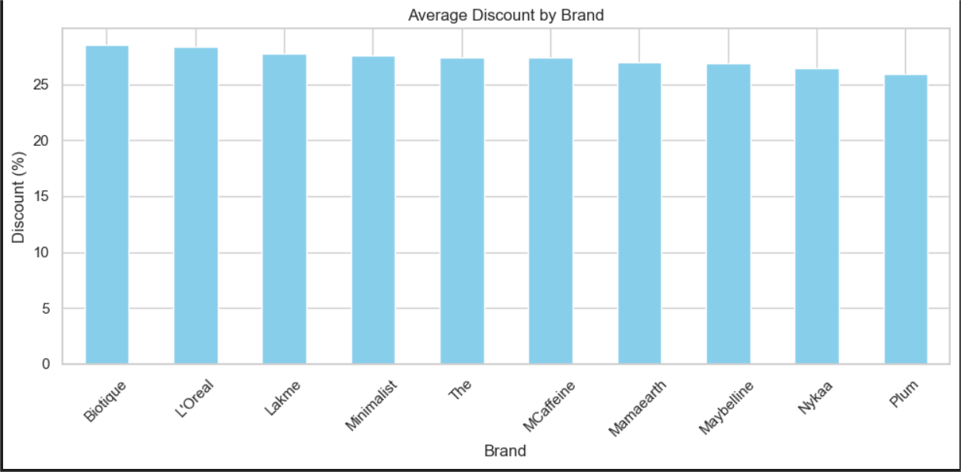
🔖 Top Brands Offering the Highest Discounts
Insight : L'Oréal offers the highest average discount at 28.68%, making it a strong promotional brand in the market.
SELECT Brand, AVG(`Discount (%)`) AS Avg_Discount
FROM beauty_sales
GROUP BY Brand
ORDER BY Avg_Discount DESC;

Slide 7
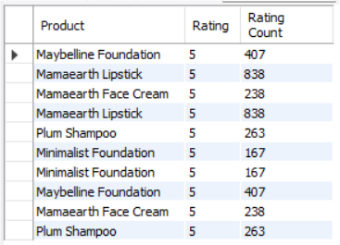
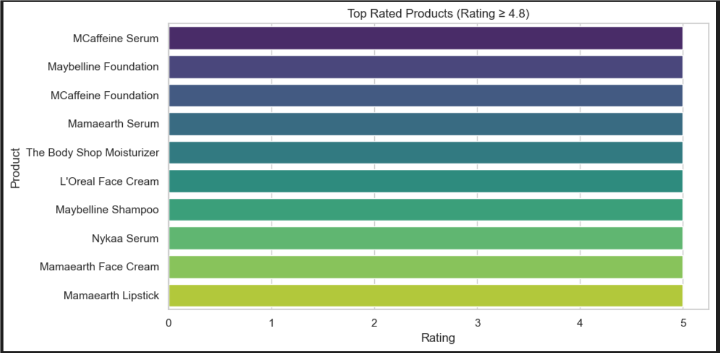
⭐ Top-Rated Products Loved by Customers
Insight : Maybelline Foundation and Mamaearth Lipstick received perfect 5.0 ratings with high review counts, indicating strong user satisfaction.
SELECT Product, Rating, `Rating Count`
FROM beauty_sales
WHERE Rating >= 4.8 AND `Rating Count` > 100
ORDER BY Rating DESC
LIMIT 10;

Slide 8
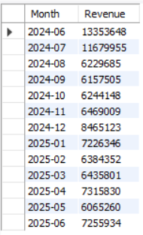
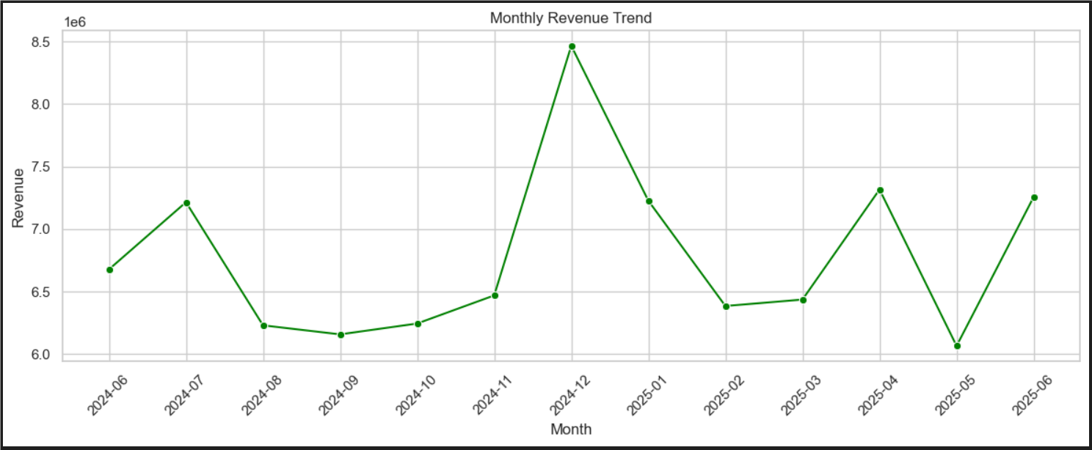
🛍️ Best-Selling Product Categories
Insight : Skincare and Makeup lead category-wise, indicating consumer focus on essentials and appearance enhancement.
SELECT Category, SUM(`Units Sold`) AS Total_Units
FROM beauty_sales
GROUP BY Category
ORDER BY Total_Units DESC;

Slide 9
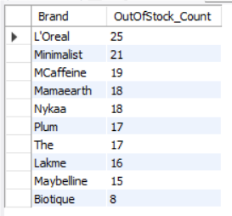
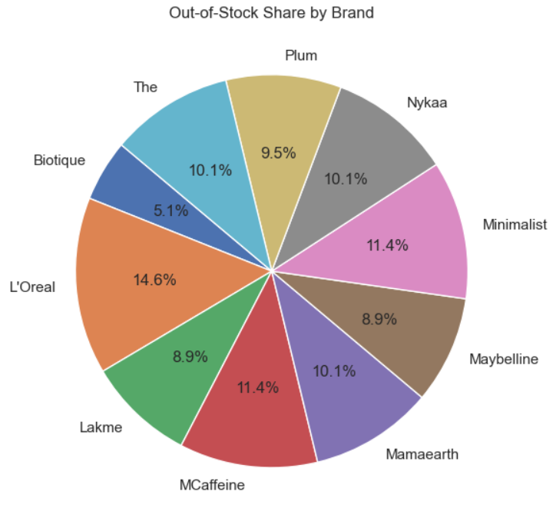
🚫 Stock Shortage by Brand
Insight : Nykaa and Minimalist had the highest number of out-of-stock products, suggesting potential demand-supply mismatch.
SELECT Brand, COUNT(*) AS Out_Of_Stock_Products
FROM beauty_sales
WHERE `Stock Status` = 'Out of Stock'
GROUP BY Brand
ORDER BY Out_Of_Stock_Products DESC;

Slide 10
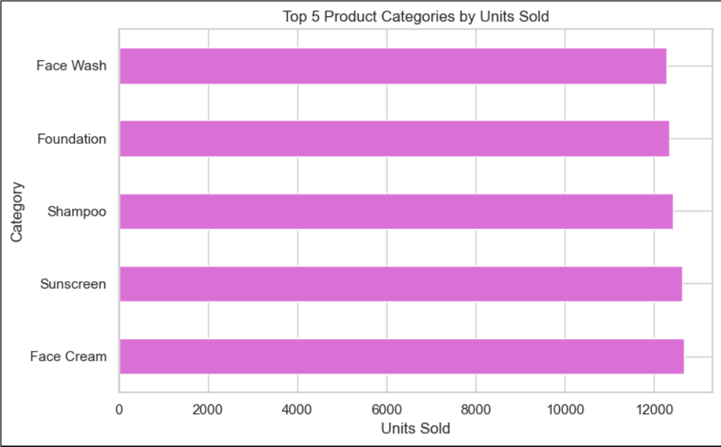
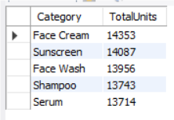
Top 5 Product Categories by Units Sold
Insight : Skincare dominates with the highest number of units sold, followed by Makeup and Haircare, showing customers' focus on personal care essentials.
SELECT Category, SUM(`Units Sold`) AS Total_Units
FROM beauty_sales
GROUP BY Category
ORDER BY Total_Units DESC
LIMIT 5;

Slide 11
What This Means for the Business
Content :
Focus marketing on Mamaearth & Plum
Improve stock availability for top-rated products
Offer smarter discounts to underperforming brands
Push highly rated products with 4.9+ ratings

Slide 12
Thank you!
🙋‍♀Shrawani Gongshe
📫 Email Me : sgongshe@gmail.com
✨ "Beauty lies in data clarity."

